Slide 1
On break points in Continuum theory
Pavel Pyrih

Slide 2
Mathematics
Continuum theory
Topology

Slide 3
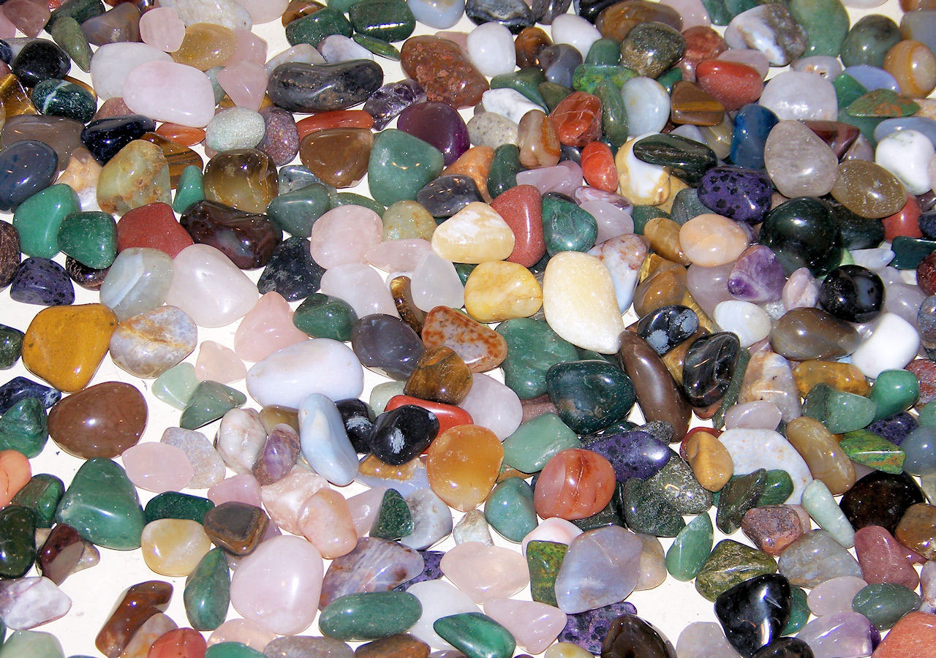

Slide 4
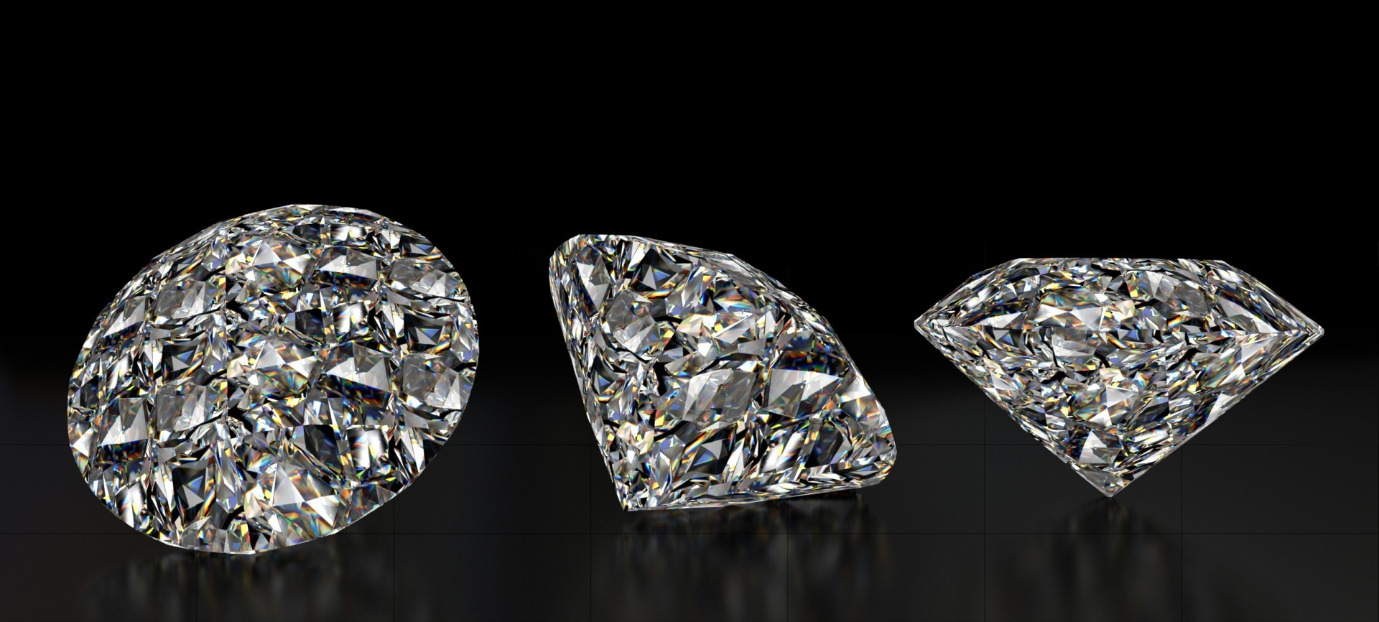

Slide 6
Janusz Jerzy Charatonik & Pawel Krupski & PP

Slide 7
Definition
Break point ( gem ) is an item
(i) written on 1 line
(ii) explained in 5 minutes

Slide 8
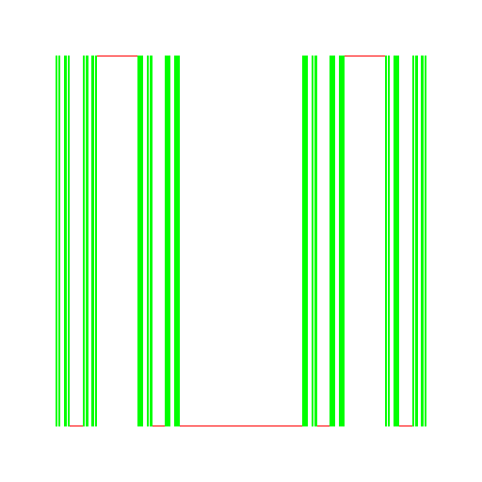
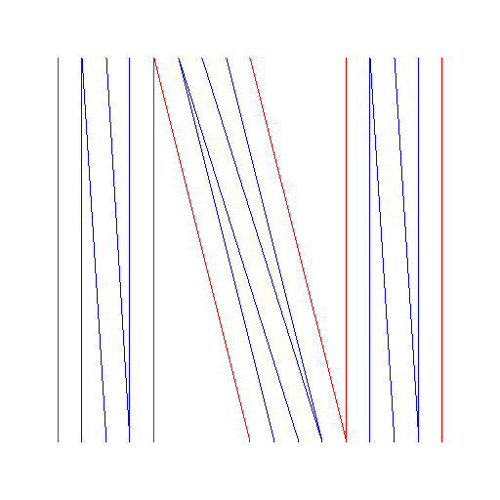
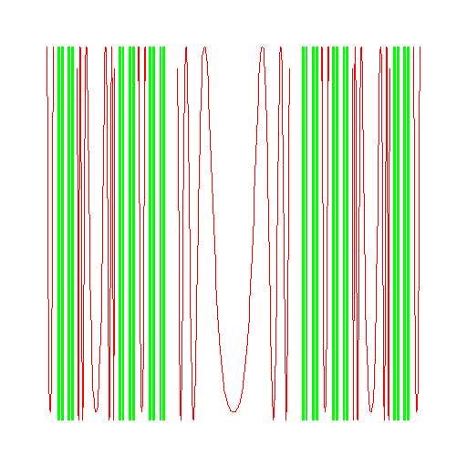
Example
Continuum is a compact playground for any small ant.
(Georg Cantor 1883)

Slide 9
Continuum Theory Gem Award
Winners
Discovering a break point (gem) in Continuum Theory.
Award
Single unique composant of any Buckethandle worldwide.
Acknowledgement
Award is given by the Continuum Theory community.

Slide 10
The Bag End composant containing the only entry point was given as the first award to Georg Cantor for the definition of a continuum.

Slide 11
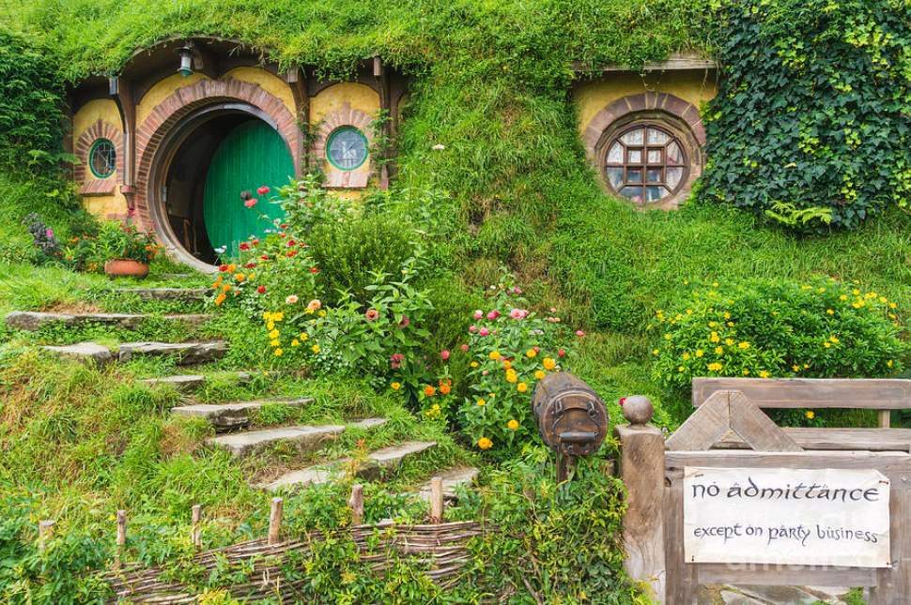

Slide 12
G. Cantor - Continuum Theory Gem Award (1883)

Slide 13
Congratulations to the award winner !!!
Thanks for the gem !!!

Slide 14
1880s
1883 | Cantor | G. | Continuum is a compact playground for any small ant.
1887 | Jordan | C. | Each simple closed planar curve surrounds its inside and outside.

Slide 15
1890s
1890 | Peano | G. | Drawing full square with a segment.

Slide 16
1900s
1900 | Hilbert | D. | Hilbert cube containing a copy of any continuum.
1902 | Painleve | P. | A decreasing sequence of continua forms a continuum.

Slide 17
1910s – page 1/2
1910 | Brouwer | L.E.J. | Buckethandle as the simplest indecomposable continuum.
1912 | Janiszewski | Z. | Arc-less continuum.
1912 | Janiszewski | Z. | Buckethandle in an angular shape.
1912 | Wada | T. | Lakes of Wada (three disjoint connected open sets of the plane with the same boundary).
1914 | Hahn | H. | Locally connected continuum is a continuous image of [0,1].
1914 | Mazurkiewicz | S. | Sierpinski carpet contains only ramification points of infinite order.

Slide 18
1910s – page 2/2
1915 | Sierpinski | W. | Half homogeneous Sierpinski carpet containing a copy of every planar curve.
1915 | Sierpinski | W. | Sierpinski triangle with only ramification points.
1916 | Moore | R.L. | Chainable continuum.
1918 | Sierpinski | W. | Any continuum is sigma connected, not a countable union of disjoint closed sets.
1918 | Janiszewski | Z. | Foundation of Fundamenta Mathematicae journal (with W. Sierpinski and S. Mazurkiewicz).

Slide 19
1920s – page 1/3
1920 | Antoine | L. | Antoine's necklace (wild embedding of the Cantor set).
1920 | Mazurkiewicz | S. | Locally connected continuum is a continuous image of [0,1].
1920 | Moore | R.L. | Two non-cut points in any continuum.
1922 | Antoine | L. | Antoine's arc (wild embedding of the arc).
1922 | Knaster | B. | Buckethandle in a round shape.
1922 | Knaster | B. | Pseudo-arc, the nondegenerate hereditarily indecomposable continuum.

Slide 20
1920s – page 2/3
1923 | Wazewski | T. | Wazewski universal dendrite containing a copy of any dendrite.
1924 | Alexander | J.W. | Alexander horned sphere, a wild embedding of a sphere into space.
1924 | Mazurkiewicz | S. | Each locally connected homogeneous plane continuum is a simple closed curve.
1925 | Gehman | H.M. | Dendrite with ramification points of order 3 and end points forming the Cantor set.
1926 | Menger | K. | Homogeneous Menger sponge containing a copy of every curve.
1927 | Kuratowski | K. | A point of irreducibility in a continuum is not contained in two proper subcontinua (a characterization).

Slide 21
1920s – page 3/3
1927 | Vietoris | L. | Solenoid (in a sequence folding tube in a previous tube twice).
1929 | Roberts | J.H. | Upper semicontinuous decomposition of the plane into nonseparating locally connected subcontinua.

Slide 22
1930s – page 1/3
1930 | Mazurkiewicz | S. | A typical continuum is hereditarily indecomposable.
1930 | Dantzig | D. von | Homogeneity of a solenoid.
1930 | Kurtowski | K. | Planability test for local dendrites (cannot contain two special continua).
1930 | Whyburn | G.T. | Whyburn's curve, a continuum every subcontinuum of which separates the plane.
1931 | Keller | O.H. | Hilbert cube is homogeneous.
1932 | Miller | E.W. | A dendrite not containing its proper copy.

Slide 23
1930s – page 2/3
1932 | Waraszkiewicz | Z. | Waraszkiewicz's spirals ( an uncountable family of continuously incomparable planar curves).
1934 | Borsuk | K. | The dunce hat (Borsuk's tube, acyclic polyhedron which is not the union of two acyclic polyhedra).
1935 | Mazurkiewicz | S. | Any compact metric space of dimension 2 contains a nondegenerate indecomposable continuum.
1936 | Whyburn | G.T. | Decomposition of 3-space into 3-space using Antoine's arc and points.
1937 | Sierpinski | W. | Arc mapped onto Hilbert cube.
1937 | Freudenthal | H. | Solenoid as an inverse limit.

Slide 24
1930s – page 3/3
1937 | Claytor | S. | Two Claytor continua block planarity of a Peano continuum.

Slide 25
1940s
1944 | Sorgenfrey | R.H. | Every nondegenerate unicoherent continuum which is not a triod is irreducible.
1945 | Besicovitch | A.S. | A dendrite such that no two of its open sets are homeomorphic.
1947 | Borsuk | K. | An example of a simple arc in space whose projection in every plane has interior points.
1948 | Bing | R.H. | Homogeneity of the pseudo-arc.
1948 | Moise | E.E. | Indecomposable planar continuum homeomorphic to each of its nondegenerate subcontinua (the pseudo-arc).
1948 | Jones | F. B. | T function (the complement of T(A) contains the interior points of subcontinua not meeting A).

Slide 26
1950s – page 1/2
1951 | Hamilton | O.H. | Each chainable continuum has the fixed-point property.
1951 | Bing | R.H. | Planar non-chainable circularly chainable hereditarily indecomposable continuum (a pseudo-circle).
1952 | Anderson | R.D. | A continuous decomposition of the plane into nonseparating subcontinua.
1958 | Anderson | R.D. | Menger universal curve is homogeneous.
1959 | Anderson | R.D. | A plane continuum no two of whose nendegenerate subcontinua are homeomorphic.
1959 | Choquet | G. | A plane continuum no two of whose nendegenerate subcontinua are homeomorphic.

Slide 27
1950s – page 2/2
1959 | Isbell | J.R. | Chainable continuum is an inverse limit of an inverse sequence of arcs.
1959 | Bing | R.H. | The circle of pseudo-arcs.
1959 | Jones | F. B. | The circle of pseudo-arcs.

Slide 28
1960s – page 1/2
1961 | Lelek | A. | The Lelek fan (a smooth fan with a dense set of endpoints).
1962 | Lelek | A. | Weakly chainable continua are exactly continuous images of the pseudo-arc.
1963 | Borsuk | K. | Borsuk nonplanar fan.
1964 | Henderson | G. | Arc is the only decomposable hereditarily equivalent continuum.
1964 | Lelek | A. | Span zero (no two points can change the position on a continuum).
1964 | Henderson | G. | The pseudo-arc is an inverse limit using only one binding map.

Slide 29
1960s – page 2/2
1964 | Charatonik | J.J. | Unicoherence of locally connected continua is an invariant under confluent mappings.
1965 | Effros | E.G. | The group of homeomorphisms acts locally.
1965 | Schori | R.M. | Universal chainable continuum.
1967 | Smale | S. | Buckethandle in a horseshoe shape as the fixed set of a mapping square into a horseshoe.
1967 | Cook | H. | Cook's continuum (a continuum admitting only the identity or a constant mapping onto itself).
1969 | Krasinkiewicz | J. | Sierpinski universal plane curve is 1/2-homogeneous.

Slide 30
1970s – page 1/4
1970 | Rogers | J.T. | A pseudo-solenoid is a common model for circle-like continua.
1970 | Rogers | J.T. | The pseudo-circle is not homogeneous.
1970 | Fearnley | L. | The pseudo-circle is unique.
1971 | Lelek | A. | Houston problem book.
1972 | Ingram | W.T. | An atriodic tree-like continuum with positive span.
1972 | Bennett | R.B. | Menger universal curve is countable dense homogeneous.

Slide 31
1970s – page 2/4
1972 | Charatonik | J.J. | Problem posing (?) challenge over problem solving (exists) and generalisations (for all).
1973 | Nadler | Sam B. Jr. | The indecomposability of the dyadic solenoid.
1974 | Rosenholtz | I. | Open image of a chainable continuum is chainable.
1975 | Ungar | G.S. | 2-homogeneous continuum is locally connected.
1977 | Hagopian | Ch.L. | Solenoids (homogeneous continua with only arc subcontinua).
1977 | Rogers | J.T. | Solenoids of pseudo-arcs.

Slide 32
1970s – page 3/4
1978 | Charatonik | J.J. | Arc-like openly homogenous continuum is the pseudo-arc.
1978 | Curtis | D.W. | Hyperspaces of closed subsets of Peano continua are Hilbert cubes.
1978 | Schori | R.M. | Hyperspaces of closed subsets of Peano continua are Hilbert cubes.
1978 | Illanes | A. | Hyperspaces of sets. Book I
1978 | Grispolakis | J. | Universal smooth dendroid.
1978 | Tymchatyn | E.D. | Universal smooth dendroid.

Slide 33
1970s – page 4/4
1979 | Bellamy | D.P. | A nonplanar tree-like continuum which admits a fixed point free mapping.
1979 | Ingram | W.T. | Hereditarily indecomposable tree-like continua.

Slide 34
1980s – page 1/3
1980 | Oversteegen | Lex G. | A dendroid with a monotone open map onto an arc.
1980 | Mill | J. van | A Peano continuum homeomorphic to its own square but not to its countable infinite product.
1980 | Iliadis | S.D. | Universal completely regular continuum (each nondegenerate subcontinuum has a nonempty interior).
1982 | Oversteegen | Lex | Indecomposable homogeneous planar continuum has span zero.
1982 | Tymchatyn | E.D. | Indecomposable homogeneous planar continuum has span zero.
1984 | Charatonik | J.J. | Example of a smooth dendroid without ordinary points.

Slide 35
1980s – page 2/3
1984 | Nikiel | J. | Gehman dendroid is the only dendrite with its set of end-points homeomorphic to the Cantor set.
1985 | Mackowiak | T. | A universal hereditarily indecomposable continuum.
1986 | Kennedy | J. | Pseudo-circle has uncountably many orbits each of which is the union of uncountably many composants.
1986 | Rogers | J.T. | Pseudo-circle has uncountably many orbits each of which is the union of uncountably many composants.
1988 | Mackowiak | T. | A characterization of finitely irreducible continua.

Slide 36
1980s – page 3/3
1989 | Charatonik | J.J. | A fan is smooth iff can be embedded into the Cantor fan.
1989 | Charatonik | W.J. | A fan is smooth iff can be embedded into the Cantor fan.
1989 | Charatonik | W.J. | Lelek fan is the unique smooth fan with a dense set of endpoints.

Slide 37
1990s – page 1/4
1990 | Kuperberg | K. | A locally connected homogeneous non-bihomogeneous continuum of dimension 7.
1990 | Krupski | P. | Homogeneous tree-like continua are hereditarily indecomposable.
1990 | Prajs | J.R. | Homogeneous tree-like continua are hereditarily indecomposable.
1991 | Minc | P. | A transitive map on [0,1] whose inverse limit is the pseudo-arc.
1991 | Transue | W.R.R. | A transitive map on [0,1] whose inverse limit is the pseudo-arc.
1992 | Nadler | Sam B. Jr. | Continuum Theory. An Introduction. Book II

Slide 38
1990s – page 2/4
1993 | Nadler | Sam B. Jr. | A continuum separated by each of its nondegenerate proper subcontinua.
1993 | Seldomridge | Gary A. | A continuum separated by each of its nondegenerate proper subcontinua.
1993 | Bellamy | D. | A tree-like continuum without the fixed-point property.
1993 | Minc | P. | An atriodic simple-4-od-like continuum which is not simple-triod-like.
1993 | Aarts | J.M. | Hairy arc.
1993 | Oversteegen | L.G. | Hairy arc.

Slide 39
1990s – page 3/4
1994 | Bandt | Ch. | Non-zero composants of the Buckethandle are homeomorphic.
1995 | Kennedy | J. | Buckethandle as an inverse limit of circles using a single bonding map.
1996 | Hagopian | Ch. L. | Simply connected plane continua have the fixed-point property.
1999 | Lewis | W. | An example of a chainable continuum that admits an exactly 2-to-1 mapping onto a continuum.
1999 | Illanes | A. | Hyperspaces. Book III
1999 | Nadler | Sam B. Jr. | Hyperspaces. Book III

Slide 40
1990s – page 4/4
1999 | Lewis | W. | Pseudo-arc maturity.
1999 | Illanes | A. | The Continuum theory hyperspace in Mexico.
1999 | Minc | P. | There exists a tree-like weakly chainable continuum without the fixed-point property.

Slide 41
2000s
2000 | Prajs | J.R. | A continuous decomposition of the Menger curve into pseudo-arcs.
2002 | Illanes | A. | Buckethandle admits no mean.
2003 | Minc | P. | Buckethandle is mapped onto a planar dedroid with point-inverses at most of cardinality 3.
2003 | Minc | P. | Planar dendroid contains a single point bottleneck.
2005 | Macias | S. | Topics on continua. Book IV

Slide 42
2010s – page 1/3
2010 | Illanes | A. | The arc is the only chainable continuum admitting a mean.
2010 | Villanueva | H. | The arc is the only chainable continuum admitting a mean.
2011 | Hoehn | L.C. | A non-chainable plane continuum with span zero.
2012 | Ingram | W.T. | Inverse limit of books on inverse limit...
2013 | Vejnar | B. | Acrless-arc, the arc-like arc-less continuum with two endpoints.
2013 | Hoehn | L.C. | An uncountable collection of copies of a non-chainable tree-like continuum in the plane.

Slide 43
2010s – page 2/3
2014 | Sturm | F. | Pseudo-solenoid is not continuously homogeneous.
2015 | Mill | J. van | Pseudo-arc is the only continuum with homeomorphically near property.
2015 | Banic | I. | Standard universal dendrite of order 3 as an inverse limit of arcs with one binding map.
2015 | Martinez-de-la-Vega | V. | Standard universal dendrite of order 3 as an inverse limit of arcs with one binding map.
2016 | Prajs | J.R. | Arcwise connected homogeneous continuum is a continuous image of the Cantor fan.

Slide 44
2010s – page 3/3
2016 | Hoehn | L.C. | Classification of planar homogeneous continua.
2016 | Oversteegen | Lex | Classification of planar homogeneous continua.
2016 | Vejnar | B. | Two non-block points in any continuum.

Slide 45
2020s
2020 | Hoehn | L.C. | Classification of hereditarily equivalent plane continua.
2020 | Oversteegen | Lex | Classification of hereditarily equivalent plane continua.

Slide 46
Name - Continuum Theory Gem Award (YEAR)

Slide 47
Congratulations to the award winners !!!
Thanks for the gems !!!

Slide 48
MORAL
of Continuum Theory Gem Award
Moral duty to give awards for gems
History track of events
History track of people
…

Slide 49
BENEFITS
of Continuum Theory Gem Award
Family status
Unique Buckethandle composant
Being in a GREAT company
Looking for the next composant

Slide 50
APPLICATION
of Continuum Theory Gem Award
Professional status
Funding, Projects, Grants, Money
PhD students
CV

Slide 52
WikipediA – Math Prizes
15 international
98 America
12 Asia
78 Europe
7 Oceania
0 Africa

Slide 53
WikipediA – Math Prizes in topology
Prize in Topology and Geometry - US
young female Armenian under 35
Prize in Geometry - US –
notable research in geometry or topology
Geometry prize - Japan –
geometry, including differential geometry, topology, and algebraic geometry

Slide 54
WikipediA – Math Prizes international
Breakthrough Prize in Mathematics
Chern Medal
Continuum Theory Gem Award
David Hilbert Award
Felix Chayes Prize
Fields Medal
...

Slide 55
WikipediA – PUBLISH or nothing
Only already published information can go in WIKI.
Continuum Theory Gem Award list of winners
(1883 - 2020 setup) should be published in
Topology and its Applications
Topology proceedings

Slide 56
Continuum Theory Gem Award
1883-2020 setup was presented
1883-2021 update will follow ???
Proposal:
Winners of the prize will update the list. Thanks.

Slide 57
B1 continuum

Slide 58
Motto: “Bee One Continuum”

Slide 60
math.cuni.cz/dl/award
math.cuni.cz

Slide 62
Media sources
gem stones
https://www.publicdomainpictures.net/en/view-image.php?image=4060&picture=gems
diamonds
https://www.publicdomainpictures.net/cs/free-download.php?image=velke-diamanty&id=205259
heart
https://www.pngegg.com/en/png-dxpmm/download
bag end
https://pixels.com/featured/bag-end-hobbiton-new-zealand-neale-and-judith-clark.html
wiki bag end
https://en.wikipedia.org/wiki/Indecomposable_continuum#/media/File:ContinuBJK.svg

